Slide 1
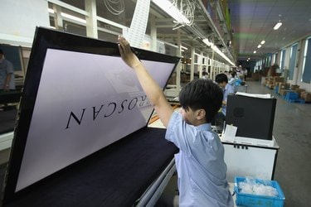
Case study on Electronic Device: FLAT SCREEN DISPLAY
Dr.M.VELAN,
Adjunct Professor

Slide 2

What Are CRT TVs?

Slide 3
How CRT TVs Work
The technology in a CRT TV revolves around a cathode ray tube.
This vacuum tube projects electrons onto a screen to create an image.
When signals come into the TV, a circuit shoots electrons down the tube to build a picture on the screen via an aperture mask.
The inside of the screen contains phosphors that create red, blue or green light; the colors and subsequent images you see on the TV occur when electrons strike the phosphor layer and light it up.

Slide 4
The Decline of CR TV
The Old CR TV used in seventees became unpopular because of their bulky size, curved screens and hefty weight and look like museum artifacts
The 1960s saw the first steps toward creating TVs with slimmer and bigger LCD and plasma displays.
These new technologies would not change consumer buying habits for some years to come, however, as the first models were very expensive. By the 2000s, lower prices and improved features made flat-screen TVs a viable choice for consumers, and CRTs became less popular.
For example, in 2005, Panasonic announced that its LCD flat panels would outsell its CRT models for the first time by 2006. Within a few years, flat-screen TVs went on to replace CRT designs.

Slide 5
Modern television sets are much thinner than their predecessors thanks to changes in the manufacturing processes and advanced materials.
Plasma and Liquid Crystal Display TVs have ditched the cathode ray tubes in favor of phosphor gas-filled cells.
Thin TVs are designed around their screen with materials and parts added on in a sterile laboratory setting

Slide 6
Case study on Electronic Device: FLAT SCREEN DISPLAY
What are raw materials for TV manufacture?
Over the course of the past more than half decade, the television has gradually become a standard household item, to the point where it is not uncommon for a household to own more than one television.
As with any object made for human consumption, the television requires materials from an earth that can only provide a finite amount of such things.
These materials come from many different sources, from many different areas of the world, and are all assembled into the different working parts that make up a television.
The materials as they are found raw in nature range from argon gas to platinum ore, and many raw materials are then combined into other secondary materials that are then assembled into the parts of the television.
Televisions depend on a wide range of these naturally found materials to be produced, but the main kinds of materials that make up a television are secondary materials produced from the combination of various raw materials, which makes the different parts of the life cycle of a television each more complex.

Slide 7
Case study on Electronic Device: FLAT SCREEN DISPLAY
What are raw materials for TV manufacture?
Exterior parts of TV : Plastics (Polyethylene & Thermosets)
Polyethylene is moulded into the specific shape that is required to encase a television, and is then set into that shape by using a thermoset.
Thermosets (urea formaldehyde) The fixing of thermosets is necessary for electronic appliances like televisions that produce a significant amount of heat, so that the plastic that encases the television will not melt down.
Glass. Glass is the essential material that makes up the screen of a television, and is made from the chemical compound silicon oxide.
Interior parts of a TV : Plastics, gases and minerals (phosphor)
Gases such as argon, neon, and xenon gas fill the television screen for the purpose of projecting colors into the screen, and are made visible by the phosphor coating that coats the inside of a television screen
Glass and lead are also found inside of a television screen. These two materials make up cathode ray tubes, which are the video display components of a television

Slide 8
Case study on Electronic Device: FLAT SCREEN DISPLAY
TV components and their manufacture
Main electrical components of TV :On the interior of a television require a large amount of silicon; these include components such as the logic board, circuit boards, and capacitors
Manufacturing process - Injection moulding process. Molten plastic is poured into a mold .Once that plastic has been set in the mold, the thermoset is applied to ensure that the plastic will not melt down again
Packaging:The televisions are usually packaged in cardboard boxes, which are commonly made from recycled paper.More plastic is then used to protect the television in the form of protective wrap such as bubble wrap. Bubble wrap is also made from the polyethylene that makes up many components of the television, making plastic a material that is essential to every stage of a television

Slide 9
Plasma Screen Manufacturing
The TV manufacturer starts with a large sheet of glass that is cuts into pieces for multiple screens.
Plasma screens use phosphor gas and electrodes sandwiched between two glass sheets.
The gas is sealed in its plasma form between these glass panes.
Very small chambers are added to the back glass plate and are coated with a different phosphorescent chemical to create different colors.
Each pixel on the screen contains one red, green and blue phosphor chamber

Slide 10
LCD Screen Building
Manufacturers also build LCD TVs by starting with the screen.
The front layer is coated with color filters and a polymer that contains the individual liquid crystals.
Three filters—one each for red, green and blue—are used for each pixel.
Electrodes, shutters and capacitors are then added to the back sheet of glass.
For LCD screens under 30 inches, plastic may be used instead of glass.

Slide 11
Case and Frame Assembly
Case study on Electronic Device: FLAT SCREEN DISPLAY
After the glass displays are created on an assembly line, they are sprayed with chemicals that add extra heat protection to the screen
Printed circuit boards are then added to the back of the display.
The screen manufacturer will then send this display to a TV manufacturer for final assembly.
The TV manufacturer will use injection molding to create the front of the TV set and then lays the screen into the case.
Signal receivers, speakers, indicator lights and control panels are then added before the plastic backing is applied.
Screws and metal for a base or mounting unit are added and then the TV is packaged and ready for sale

Slide 12
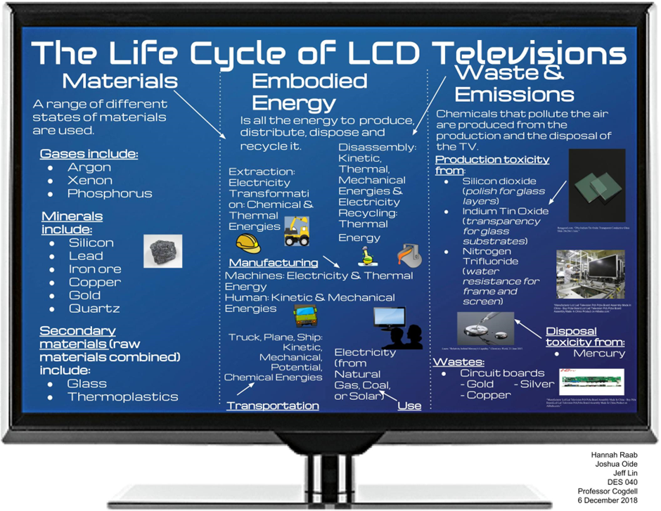
Life Cycle of LCD Televisions

Slide 13
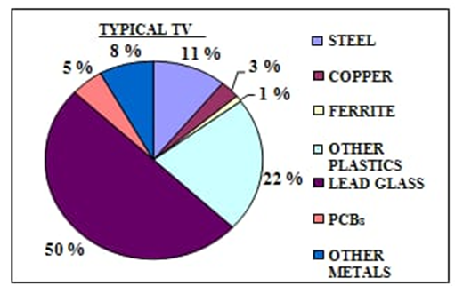
Case study on Electronic Device: FLAT SCREEN DISPLAY
Glass the largest component of a flat-screen TV
Neon, xenon and argon gases combined into phosphor gas for the cells that make up their displays.
Cerium is used to improve the color of your screen.
The electronics and case feature materials such as plastics, copper, tin, zinc, silicon, gold and chromium are used
MATERIAL COMPOSITION OF MODERN TV

Slide 14
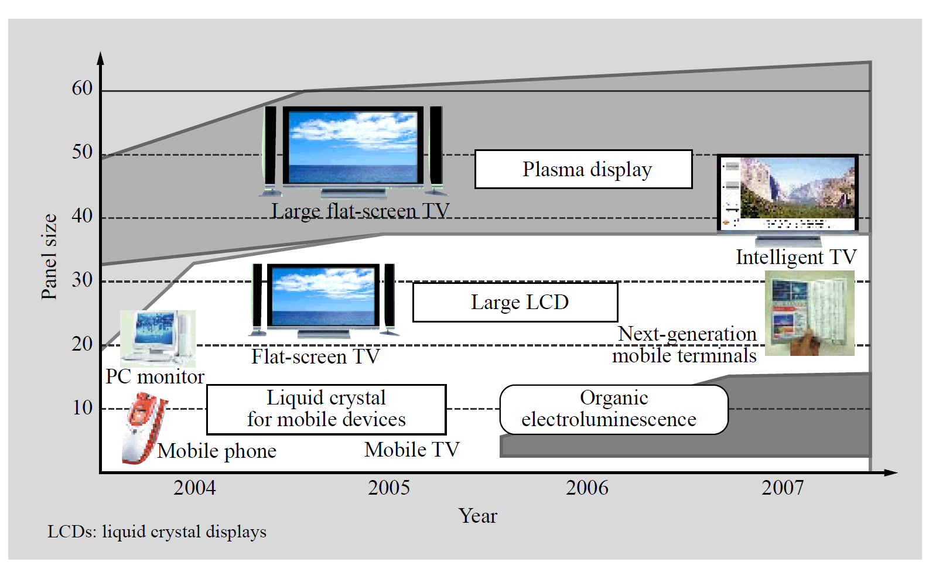
Fig. 1—Trends in Flat Panel Display Screen Sizes.
In the larger screen sizes greater than 30 inches, LCDs and plasma displays for thin-screen TVs are the main technologies.
Currently smaller displays for mobile devices size are monopolized by liquid crystal, but there is a good chance that organic electroluminescence displays will become available for handheld devices in a few years.

Slide 15
TV accessories and its material
Once the televisions reachs home, it must be plugged into power using wires and power outlets, which use metal and polyethylene plastic, respectively. most wires that power televisions are made from copper, as copper is a relatively cheap conductive metal
TV remotes are also mainly made from plastic. The plastic most commonly used in TV remotes is a thermoplastic polycarbonate made from acrylic plastic
DVD players use a fair amount of thermoplastics as well for the outer casing, as well silicon for many of the interior

Slide 16
Latest development in TV Technology and
materials Research
Strict product specifications for many of the materials and components are needed to produce state-of-the-art flat-screen display modules.
The current developments are among optical components ( wholographic optical waveguides), micro-lens arrays, color resists for LCD color filters, high-performance ACFs, electromagnetic wave shielding films, antireflection films, and new module packaging COF technology.
Holographic waveguides : mitigates the shadowy dark areas between LEDs which inevitably occur when LEDs are used as the light source and fixes extremely weak vertical dispersion in the vertical direction between LEDs .
Microlens Array : MLAs Formed on Glass Substrate to semi-transmissive
LCDs is also beneficial, for it not only improves efficiency by focusing the transmitted light but also boosts the reflectivity by expanding the reflecting area of the pixels

Slide 17
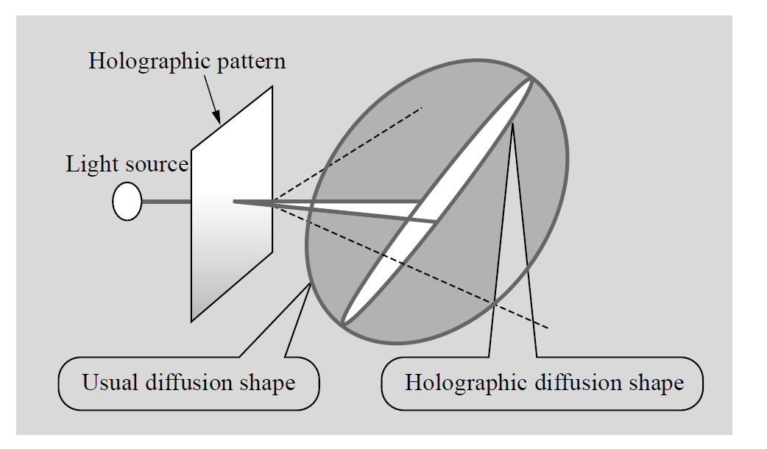
Holographic wave guide
Holographic Diffusion Pattern : Holographic patterns are unique in the linear diffusion pattern of the light.

Slide 18
Case study on Electronic Device: FLAT SCREEN DISPLAY
MLAs (microlens arrays) are one- or two dimensional arrays of minute lenses ranging from several microns to several hundred microns in diameter, and are used in CCD (charge-coupled device) image sensors, 3D display elements, optical communications, and a host of other optical devices.
More recently, there has been an intense effort to
apply MLAs to LCDs. For example, by installing
MLAs directly above a liquid-crystal backlight unit
the optical path from the light source can be
controlled, and by incorporating MLAs in the valve
of a liquidcrystal projector, the light usage
efficiency can be markedly improved by exploiting
the focusing action of the lenses.
SEM Images of Microlens Array Formed on Glass
Substrate.

Slide 19
Case study on Electronic Device: FLAT SCREEN DISPLAY
Color Resists for LCD Color Filters
Color resists are liquefied resists in which negative UV (ultraviolet)-cured resists are doped with submicron organic pigments, and they are used in the manufacture of color filters for LCDs to achieve colour purity.
Large LCDs—particularly those used for TVs— require high contrast and excellent color purity in terms of the color characteristics, and demand uniform coating using a slit coater on large glass substrates measuring at least one meter square in terms of processing characteristics

Slide 20
Case study on Electronic Device: FLAT SCREEN DISPLAY
Example of Coating by Slit Coater.

Slide 21
Case study on Electronic Device: FLAT SCREEN DISPLAY
Anisotropic Conductive Films (ACF)
LCDs must provide a way for the circuits deposited on the glass substrate to interconnect with the multitude of tiny outer leads on the driver chip that drives the Display.
ACF is essentially a tape adhesive that is doped with conductive particles and simplifies interconnection processing automation.
The ACF is inserted between the circuits to be interconnected, and anisotropic conductive interconnection is achieved by the application of heat pressure to provide conductivity between the facing circuits and insulation from other circuits.
Two types of conductive particles are used on the film—nickel and other metallic particles and metal-coated resin particles—and the diameters of the particles range in size from 2 to 10 micrometer
The new adhesive system works at the low temperature of 150ºC, sets up quickly (10 seconds at 150ºC

Slide 22
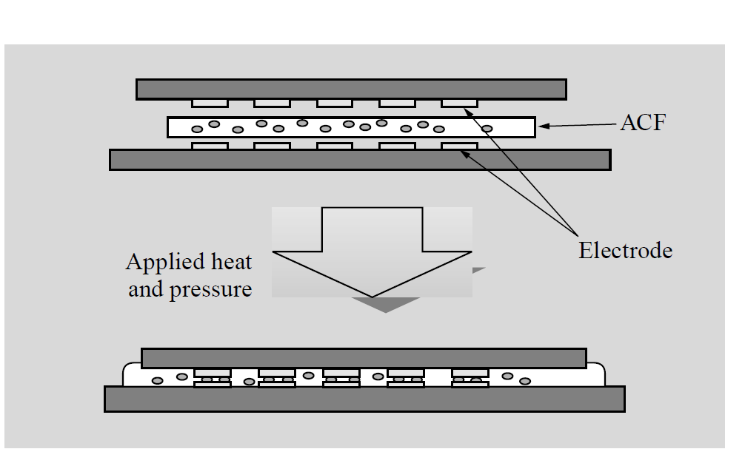
Case study on Electronic Device: FLAT SCREEN DISPLAY
Photo of ACF
Interconnecting Circuits by ACF.

Slide 23
Case study on Electronic Device: FLAT SCREEN DISPLAY
Anti-reflection Films for Displays
PDPs and LCDs must be provided with antireflection films in order to minimize reflections and glare caused by outside light. high-performance
Three-layer antireflection film consists of a hard coat layer, a medium refractive layer, a high refractive layer, and a low refractive layer that are deposited onto a PET (polyethylene terephthalate) film substrate by the wet coating method.
By depositing these thin layers that have different refractive indexes at just the right thicknesses, the resulting optical interference acts to effectively reduce reflected light.
Three well-known antireflection coatings are aluminum oxide, silicon nitride, and silicon oxide, MgF₂/Al₂O₃/ZnS

Slide 24
Case study on Electronic Device: FLAT SCREEN DISPLAY
Packaging solutions
While there are various practical packaging solutions using ACF, the COF (chip-on-film) substrate package is a new approach that achieves good adhesion for two-layer FPCs (flexible printed circuits) and provides excellent adhesion reliability against stress and absorption for different chip-film interconnect structures.
This technology is attracting widespread interest as alead-free environmentally-friendly material enablinglow-temperature interconnection. ACF technology has already led to a transformation in packaging methodology.
It is certain to have other major benefits—sustained reliability, better resolution, and improved manufacturability—and Hitachi is now working on a new generation of ACF products that incorporate these features

Slide 25
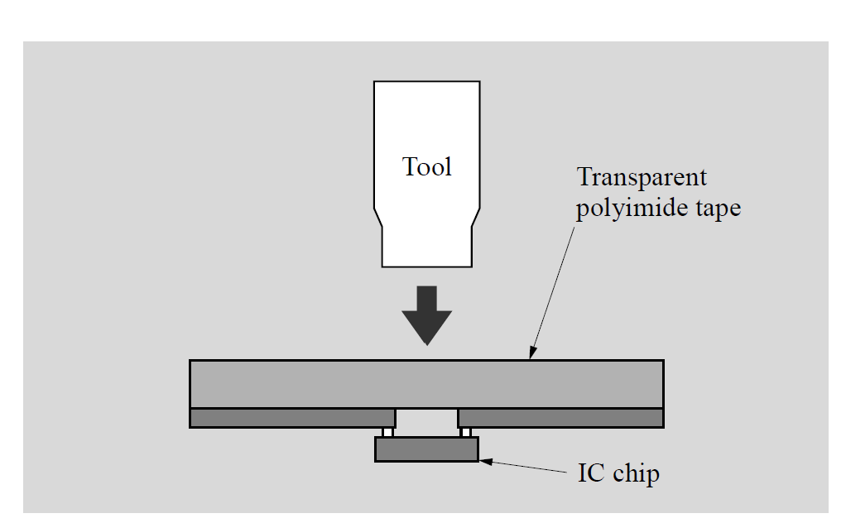
Case study on Electronic Device: FLAT SCREEN DISPLAY
Chip On Film (COF) Tape
As large LCD TVs become increasingly popular, we are seeing increased production of TAB (tape automated bonding) tape for mounting the driver IC
(integrated circuit) that drives the liquid-crystal circuits. The conventional TAB method, called the flying lead structure, is illustrated in Fig below. An opening (device hole) is opened at the place where the chip is to be mounted, and an inner lead providing the interconnect with the chip electrode sticks out into
Schematic of COF Interconnect Method

Slide 26
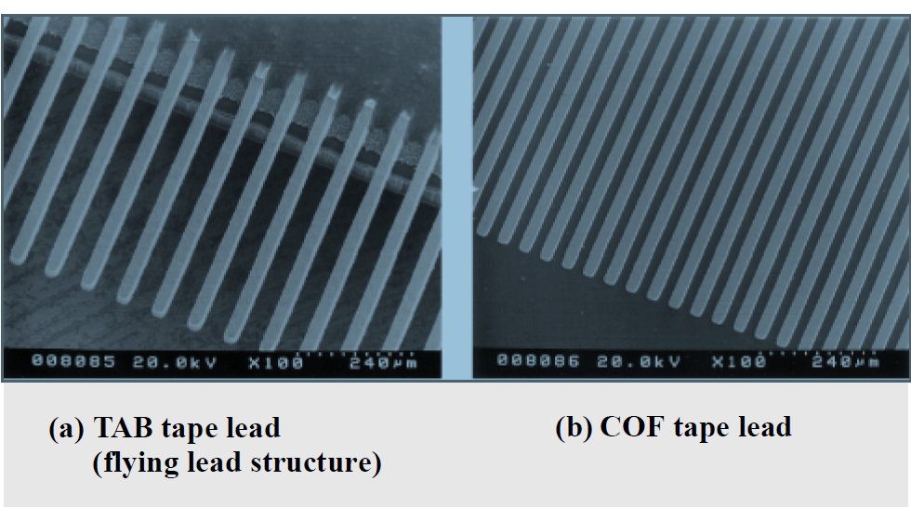
Case study on Electronic Device: FLAT SCREEN DISPLAY
SEM Photographs of Inner Lead Using TAB Method and COF Method
The COF method is capable of forming fine-featured interconnects with a pitch of less than 40 μm.

Slide 27

Case study on Electronic Device: FLAT SCREEN DISPLAY

